Slide 1

Smart Notification System for Nursing homes JOVIN YAP KUANG YONG U1421323K

Slide 2
OUTLINE OF PRESENTATION
INTRODUCTION
REVIEW OF
EXISTING WORKS
METHODOLOGY
RESULTS AND
DISCUSSION
CONCLUSION
Notes:
Overview- Motivation, current situation, project objectives

Slide 3

1.
INTRODUCTION

Slide 4

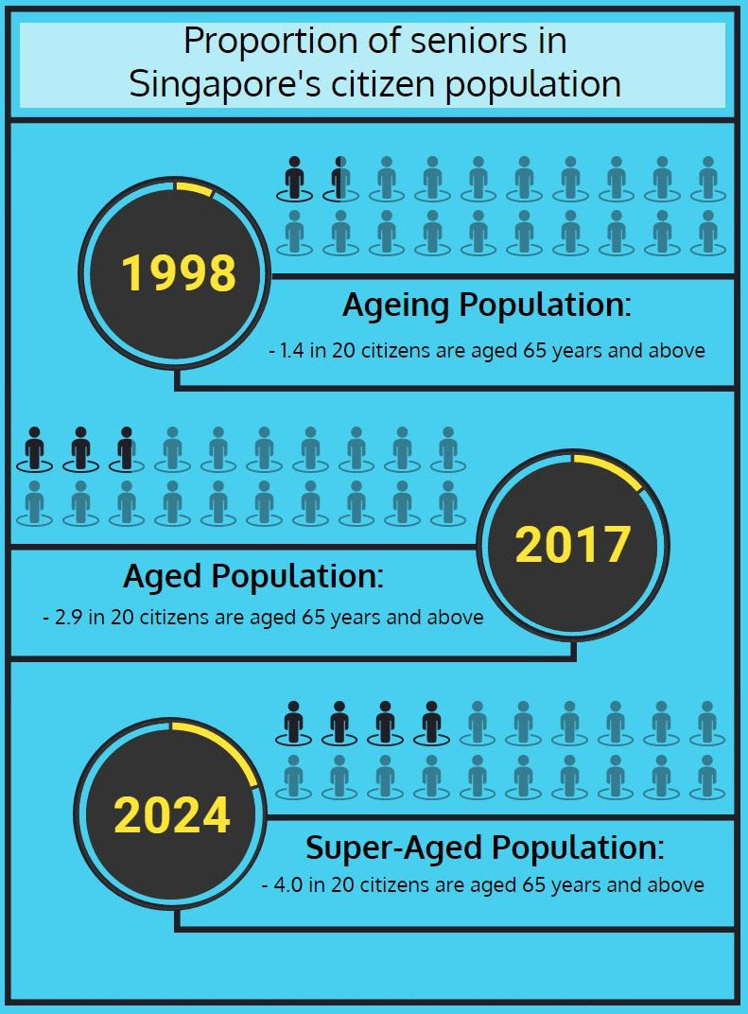
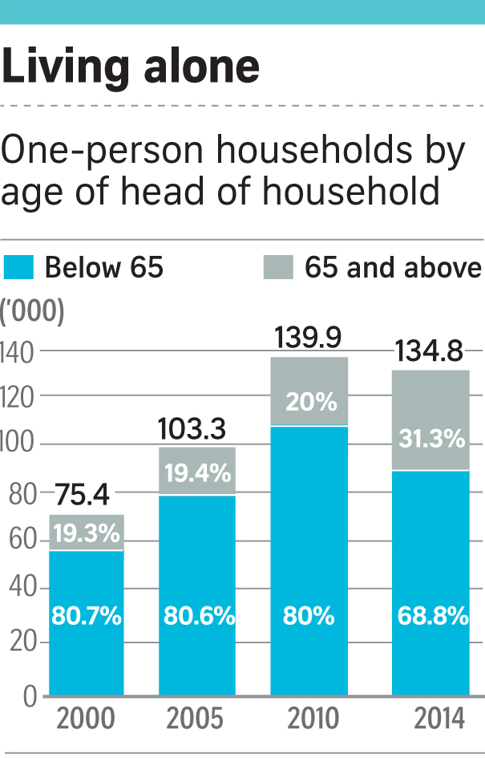


Motivation
INTRODUCTION
REVIEW OF
EXISTING WORKS
METHODOLOGY
RESULTS AND
DISCUSSION
CONCLUSION
Notes:
Growing number of elderly in Singapore
Number of elderly people living alone are also estimated to rise in the near future\
Overworked nursing staffs: affect work performance and hinders the timely assistance the elderly need and deserve.

Slide 5

2.
REVIEW OF EXISTING WORKS
Notes:
Moving on to the next section, now I will proceed to sharing the works and technological solutions that I have researched in the literature review.
In fact, the solutions mentioned in the literature review have already started tackling the issue of overworked staff and they are trying to improve the situation.
I have categorized these solutions into 2 main categories, namely robot based nursing staff support system and notification system for nursing staff.

Slide 6
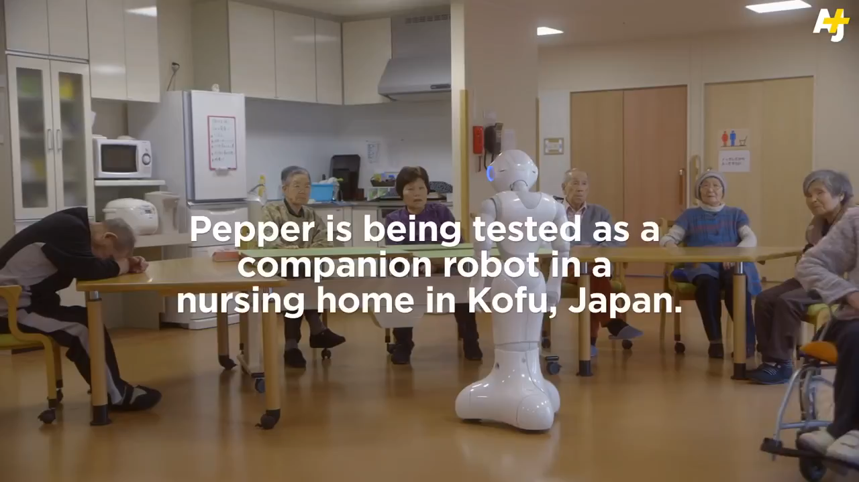
Robots based Nursing Staff Support System
INTRODUCTION
Robots built with capability to perform tasks of a human caregiver
Capabilities include:
Interaction with elderlies
Navigating around the care-centre
Path guiding
Cleaning
REVIEW OF
EXISTING WORKS
METHODOLOGY
RESULTS AND
DISCUSSION
CONCLUSION
Notes:
Technological solutions aiming to address the Category
Overview of technological based solutions introduced
Nursing home staffs substitute using robots
Nursing home staffs support- ontology based nurse call system
Abnormality detection
List the good points and not-so-good points

Slide 7
INTRODUCTION
Robots based Nursing Staff Support System- Management of Robots
REVIEW OF
EXISTING WORKS
Usually Heterogeneous robots are deployed in care centre
Requires specialized algorithm to schedule task effectively
Consensus Based Parallel Auction and Execution (CBPAE) algorithm
Bid value calculated based on certain factors such as the expertise and work estimate of the task
METHODOLOGY
RESULTS AND
DISCUSSION
CONCLUSION
Notes:
Heterogeneous robots: robots with different capabilities functioning in a care centre
-Require a good management system

Slide 8
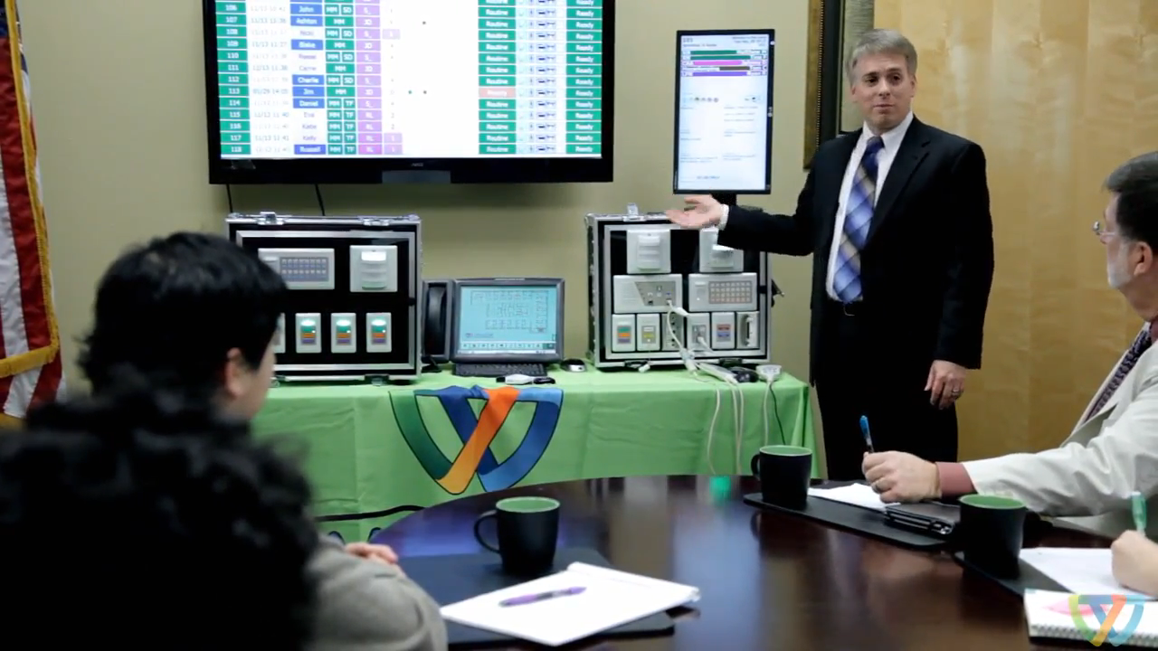
INTRODUCTION
Traditional Notification Systems for Nursing Staff Support
REVIEW OF
EXISTING WORKS
METHODOLOGY
Colours signify different meaning
Constant look out for alert
RESULTS AND
DISCUSSION
CONCLUSION
Notes:
Traditional way of notifiying

Slide 9

INTRODUCTION
Modern Notification Systems for Nursing Staff Support
REVIEW OF
EXISTING WORKS
Incorporates Ontology
Takes in context information when allocating a task
Notification mechanism: Hands-free devices e.g. smart watches worn on caregivers
METHODOLOGY
RESULTS AND
DISCUSSION
CONCLUSION
Relationship with care-receivers

Slide 10
Simulation used in Healthcare Systems
INTRODUCTION
REVIEW OF
EXISTING WORKS
METHODOLOGY
Ontology based Notification system evaluated using Discrete Event Simulation (DES)
Also applied to help in decision making on adding new facilities
RESULTS AND
DISCUSSION
CONCLUSION
Notes:
Discrete Event Simulation (DES)

Slide 11




INTRODUCTION
Summary of Review Staff Support Systems
REVIEW OF
EXISTING WORKS
Robots managed to increase the quality of service to the care-receivers
METHODOLOGY
RESULTS AND
DISCUSSION
However, not directly supporting the duty of caregivers i.e. Substitution of manpower
CONCLUSION
Implementation of task allocation algorithm for robots is worth noting down
Benefits of simulation in healthcare system

Slide 12
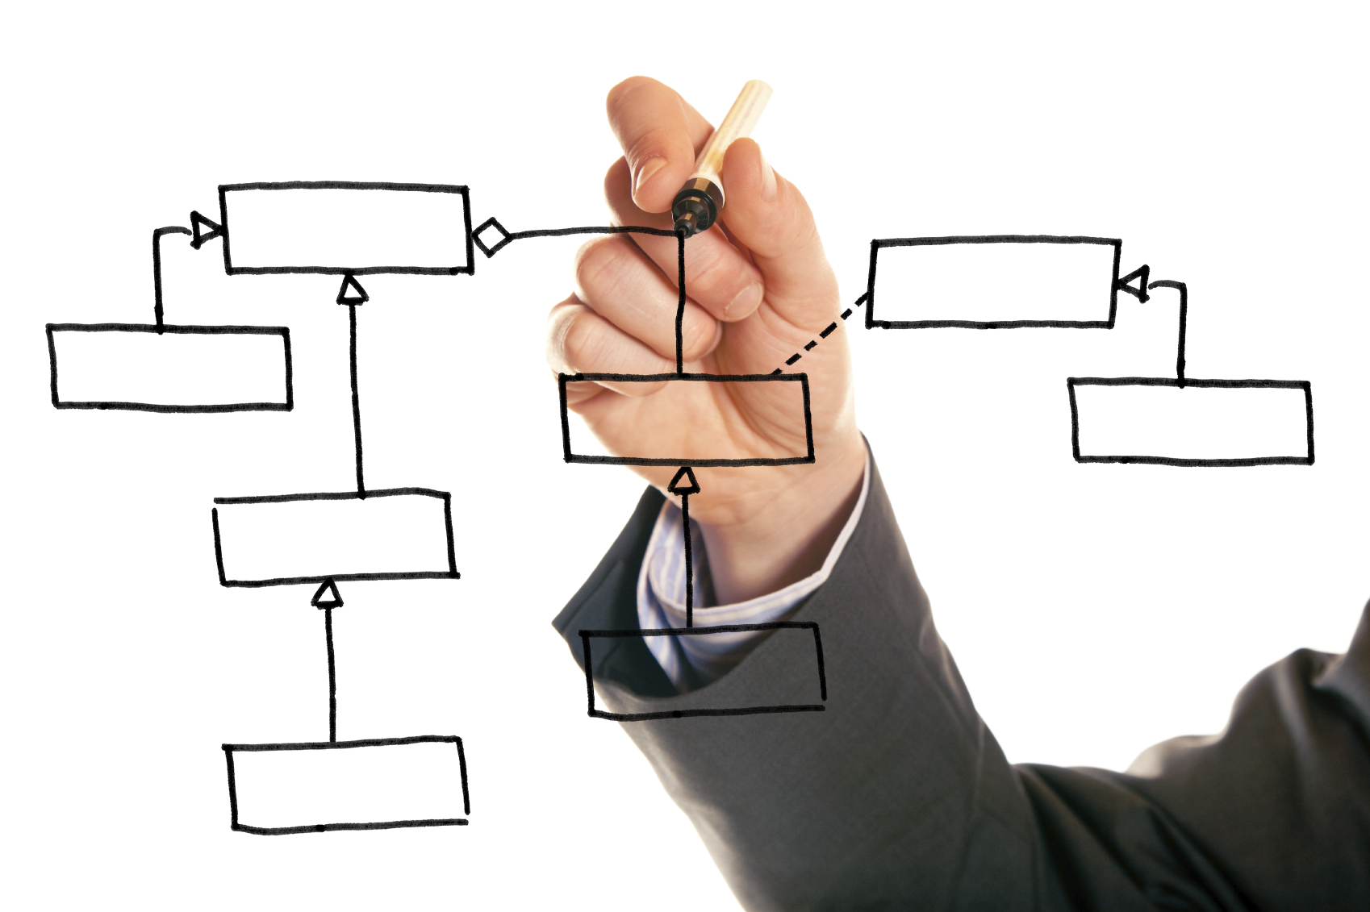
3.
METHODOLOGY

Slide 13
Limitation of Existing Solution
INTRODUCTION
Lack of direct support for caregiver’s day-to-day duty
REVIEW OF
EXISTING WORKS
METHODOLOGY
RESULTS AND
DISCUSSION
Lack of visualization for implemented algorithm in caregivers’ task allocation
CONCLUSION
High cost of implementation
Notes:
To develop a smart detection system that detects abnormal situations in an elderly care-centre environment and assigning the identified situation to a relevant caregiver based on a set of rules. This system provides support to the duty caregivers as less monitoring work will be needed.
2) To design various task allocation algorithm and perform assessment on its performance and effect it has on various key performance indicators. Stakeholders can then evaluate the assessment result and implement the algorithm that helps in achieving the desired key performance indicator.
4
3) To design a simulator that simulates the operating behaviour of the smart detection system. The simulation serves as a form of visualization on how the task allocation functions in the actual environment, thus helping stakeholders to understand the function of the algorithm and facilitates adjustments if needed.
4) To make use of location data provided by Bluetooth Beacon, a type of Bluetooth Low Energy (BLE) device. This replaces the need of installing various sensors to detect movement and monitoring of elderlies, thus being more cost saving.

Slide 14
Project Objectives
INTRODUCTION
Identify abnormality by using location data generated by Bluetooth Beacon
REVIEW OF
EXISTING WORKS
METHODOLOGY
RESULTS AND
DISCUSSION
Project Objectives
CONCLUSION
Perform task allocation to caregivers
Build a simulator that simulates the operating behavior
Notes:
To develop a smart detection system that detects abnormal situations in an elderly care-centre environment and assigning the identified situation to a relevant caregiver based on a set of rules. This system provides support to the duty caregivers as less monitoring work will be needed.
2) To design various task allocation algorithm and perform assessment on its performance and effect it has on various key performance indicators. Stakeholders can then evaluate the assessment result and implement the algorithm that helps in achieving the desired key performance indicator.
4
3) To design a simulator that simulates the operating behaviour of the smart detection system. The simulation serves as a form of visualization on how the task allocation functions in the actual environment, thus helping stakeholders to understand the function of the algorithm and facilitates adjustments if needed.
4) To make use of location data provided by Bluetooth Beacon, a type of Bluetooth Low Energy (BLE) device. This replaces the need of installing various sensors to detect movement and monitoring of elderlies, thus being more cost saving.

Slide 15
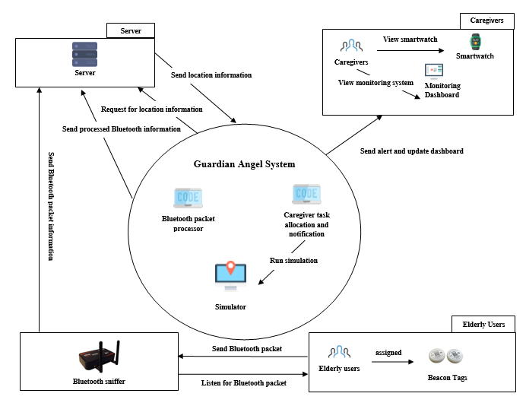
INTRODUCTION
REVIEW OF
EXISTING WORKS
METHODOLOGY
RESULTS AND
DISCUSSION
CONCLUSION
Notes:
Overview of the system: context diagram. Explanation of Guardian Angel
The focus of presentation, part developed by me. 1) detection 2) task allocation 3) simulation
Coverage of the detection, task allocation (emphasize on idea not algorithm efficiency), technology/software used in the implementation.
Architecture used: Benefit of arc

Slide 16
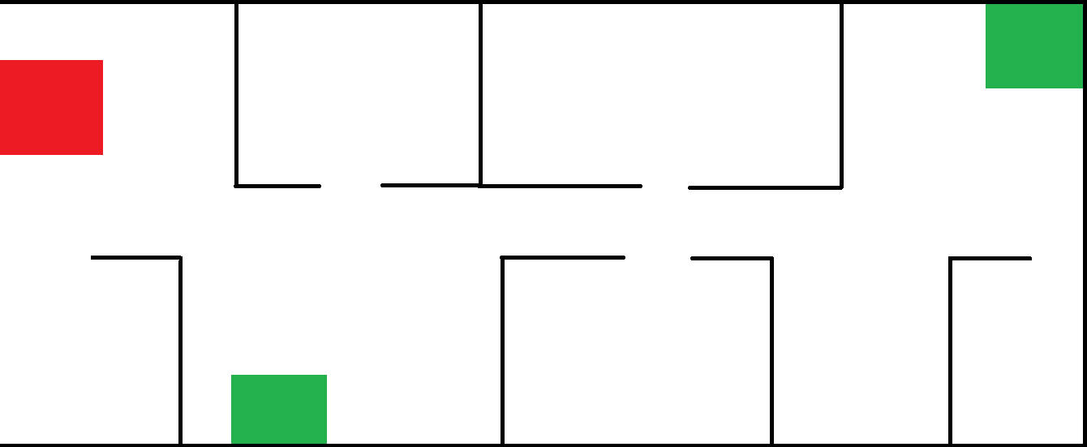
Back-end Simulator
INTRODUCTION
REVIEW OF
EXISTING WORKS
METHODOLOGY
RESULTS AND
DISCUSSION
Floorplan
CONCLUSION
Provides location information to the task allocation and notification module
Simulated environment of a nursing home

Slide 17
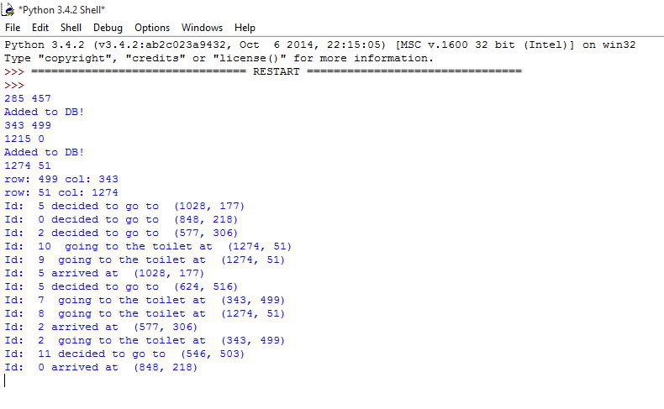
Back-end Simulator
INTRODUCTION
REVIEW OF
EXISTING WORKS
METHODOLOGY
RESULTS AND
DISCUSSION
Python console
CONCLUSION
Simulates movement and activity of caregivers and care-receivers on floorplan
Saves location information in database and upload to server

Slide 18
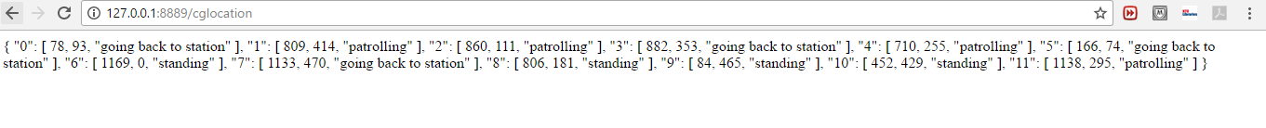
Back-end Simulator
INTRODUCTION
REVIEW OF
EXISTING WORKS
METHODOLOGY
RESULTS AND
DISCUSSION
Server Message
CONCLUSION
HTTP GET request to server to retrieve location information in JSON format

Slide 19
INTRODUCTION
Task Allocation and Notification Module – Features Implementation
REVIEW OF
EXISTING WORKS
Abnormality detection: perform checks on the location of elderlies at a specified interval
Task allocation: score based allocation system
Scores decided by following a set of formulas which include: Distance, status, expertise and remaining time on current task
METHODOLOGY
RESULTS AND
DISCUSSION
CONCLUSION

Slide 20
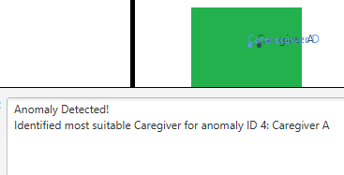
INTRODUCTION
Feature Implementation – Abnormality Detection
REVIEW OF
EXISTING WORKS
METHODOLOGY
RESULTS AND
DISCUSSION
Abnormality detected
CONCLUSION
Abnormality: Care-receiver in washroom

Slide 21
Features Implementation – Task Allocation
INTRODUCTION
REVIEW OF
EXISTING WORKS
Task allocation Algorithm 1
Task allocation Algorithm 2
METHODOLOGY
Policy
To provide better quality of service
To provide efficient work allocation
RESULTS AND
DISCUSSION
CONCLUSION
Factors involved
Status of caregivers
Distance between caregiver to abnormality location
Remaining time on current task
Expertise level
Status of caregivers
Distance between caregiver to abnormality location
Remaining time on current task

Slide 22
INTRODUCTION
Features Implementation – Explanation of Score Calculation
REVIEW OF
EXISTING WORKS
Task allocation Algorithm 1
Task allocation Algorithm 2
METHODOLOGY
Status of caregiver
Remaining time on current task
RESULTS AND
DISCUSSION
CONCLUSION
Score = S x (1/D) x (1/R) x E
E
Distance of caregiver to abnormality
Expertise Level
Notes:
Animation to remove E for algo 2

Slide 23
Front-end Simulator
INTRODUCTION
REVIEW OF
EXISTING WORKS
Provides the visualization of the back end simulator
Customize simulation settings
Generates simulation results
METHODOLOGY
RESULTS AND
DISCUSSION
CONCLUSION

Slide 24

Front-end Simulator – GUI Implementation
INTRODUCTION
REVIEW OF
EXISTING WORKS
Stage
METHODOLOGY
Scene
RESULTS AND
DISCUSSION
HBox
Scene graph
CONCLUSION
Group
VBox
Pane
Group
Label
Label
Buttons
Cells
Notes:
JavaFX
set of graphics and media packages that can be operated across different platforms.
JavaFX scene graph API
holds a set of nodes with each node playing the role of either a branch or leaf node.
layout comprising of a Stage, Scene, Containers.
Explain stage

Slide 25
Front-end Simulator - Features
INTRODUCTION
REVIEW OF
EXISTING WORKS
METHODOLOGY
RESULTS AND
DISCUSSION
CONCLUSION
Simulation results

Slide 26
Front-end Simulator - Features
INTRODUCTION
REVIEW OF
EXISTING WORKS
METHODOLOGY
RESULTS AND
DISCUSSION
Customizable Settings Page
CONCLUSION
Input Validation

Slide 27
Front-end Simulator - Demo
INTRODUCTION
REVIEW OF
EXISTING WORKS
METHODOLOGY
RESULTS AND
DISCUSSION
CONCLUSION

Slide 28

4.
RESULTS AND DISCUSSION
Notes:
Simulation set-up and presentation of experiment results
Correctness of algorithm (screenshots of specific scenario in the simulation)
Demo of the simulation

Slide 29
Experiment Objectives
INTRODUCTION
Effect of algorithm 1 and 2 on the work distribution among the caregivers
Change in the ratio of trained to untrained caregivers affect the number of missed/late handling of abnormalities
Optimal number of caregivers required given a group of care-receivers
REVIEW OF
EXISTING WORKS
METHODOLOGY
RESULTS AND
DISCUSSION
CONCLUSION

Slide 30
Experiment Set-Up
INTRODUCTION
REVIEW OF
EXISTING WORKS
Multiple rounds of simulation with each round lasting approximately 60 mins
Variation made in each round of simulation
Variations include:
Ratio of caregivers both trained to untrained
Selection between 2 different task allocation algorithm
METHODOLOGY
RESULTS AND
DISCUSSION
CONCLUSION

Slide 31
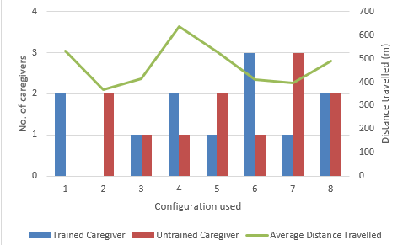
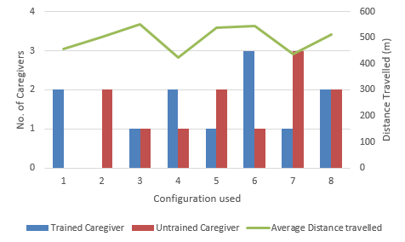
Experiment – Result Analysis
Average Distance Travelled
INTRODUCTION
REVIEW OF
EXISTING WORKS
METHODOLOGY
RESULTS AND
DISCUSSION
CONCLUSION
Algorithm 1
Algorithm 2
Notes:
Roughly covers the same amount of distance in both algorithm
Still useful if companies can track the distance travelled before implementation and compare the effect

Slide 32
Experiment – Result Analysis
INTRODUCTION
Task Distribution
REVIEW OF
EXISTING WORKS
METHODOLOGY
RESULTS AND
DISCUSSION
CONCLUSION
Algorithm 1
Algorithm 2
Notes:
Distribution of works
Trained caregivers will be getting more but more balanced in algorithm 2

Slide 33
Number of missed/late call across different caregiver ratio
Experiment – Result Analysis
INTRODUCTION
REVIEW OF
EXISTING WORKS
METHODOLOGY
RESULTS AND
DISCUSSION
CONCLUSION
Algorithm 1
Algorithm 2
Notes:
The drop in missed/late call % per additional manpower added.
Effect of having trained and untrained

Slide 34
Experiment Conclusion
INTRODUCTION
Both task allocation algorithms have achieved their expected effect
REVIEW OF
EXISTING WORKS
METHODOLOGY
To monitor a group of 12 care-receivers, 4 caregivers are sufficient
RESULTS AND
DISCUSSION
CONCLUSION
Trade-off between quality of service and distribution of work as a point to consider by the stakeholders
Such experiments can be conducted to help stakeholders make management decision
Notes:
By answering to the first 2 key questions 1) how selection choice between task allocation algorithm 1 and 2 would affect the work distribution among the caregivers, and 2) how ratio of trained to untrained caregivers can affect the number of missed/late handling of abnormalities.
The contrasting difference seen in the number of tasks allocated to caregivers have shown that by prioritizing quality of service to the care-receivers, trained caregivers will be assigned with more tasks.
a point to consider by the stakeholders when deciding on the trade-off between quality of service and distribution of work.

Slide 35

5.
CONCLUSION

Slide 36
Conclusion – Summary of Achievements
INTRODUCTION
REVIEW OF
EXISTING WORKS
Low-cost system achieved: Usage of location information generated by Bluetooth Beacons
METHODOLOGY
RESULTS AND
DISCUSSION
Included visualization feature for stakeholders to visualize and to test the implemented algorithm in a simulated environment
CONCLUSION
Evaluation of task allocation to caregivers

Slide 37
Conclusion- Limitations and future works
Conclusion – Limitations and Future Work
INTRODUCTION
Limitation 1: Abnormality detection module only caters to just one specific situation
REVIEW OF
EXISTING WORKS
Upgrade scope by extending the types of information processed, such as health monitoring data (e.g. Heart rate)
METHODOLOGY
RESULTS AND
DISCUSSION
Limitation 2: Skewed distribution of work when prioritizing quality service to the elderlies
To consider more factors in the design of the algorithm so that the biasness of assigning a task to trained caregivers could be reduced
CONCLUSION
Limitation 3: simulator provides limited support for professional users
Adding statistical functions to facilitate professional users on statistical analysis

